Slide 1
Graph-based Semi-Supervised Learning
Presenter: Yuchao Tao

Slide 2
Why we need semi-supervised learning?
Unlabeled
Labeled

Slide 3
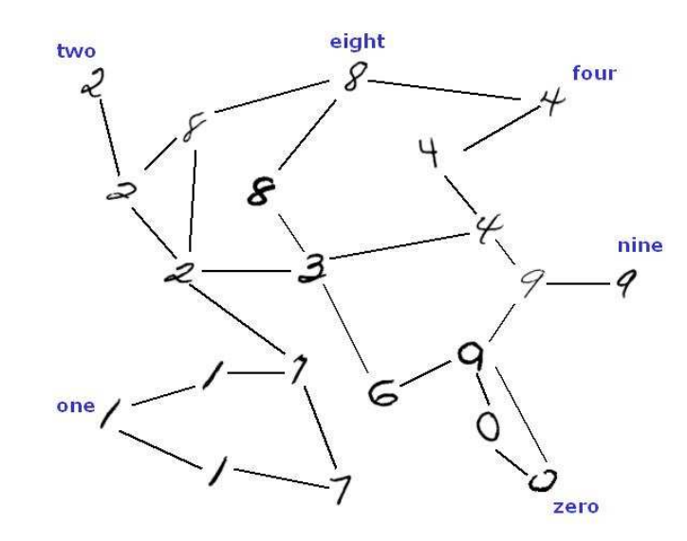
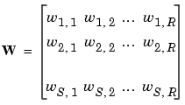
What is a Graph-based Semi-Supervising Model?
A data manifold, or a data set interpreted in a graph
Labeled
A weight matrix to define the data manifold
Unlabeled

Slide 4







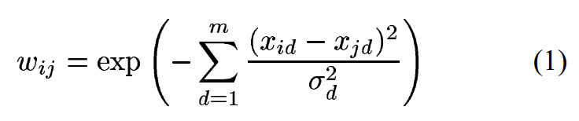
Define weight matrix
Question: What is the advantage to use a Gaussian form to define the weight?
Answer: Make the distance more sensitive. Adjacent points can be assigned higher weight.

Slide 5


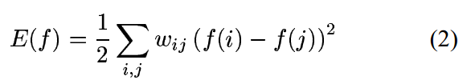




Gaussian Random Field
Under this condition:
To minimize this Quadratic
Energy function
#: Concepts from Thermodynamics

Slide 6
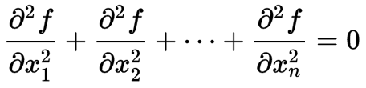










Harmonic Function
A harmonic function is a function which satisfies Laplace’s Equation
Laplace’s Equation:
<=>
<=>

Slide 7


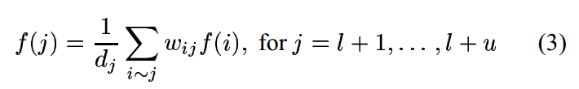



Analytic solution to function f
< = >
Maximum principle of harmonic functions (Doyle & Snell, 1984)

Slide 8
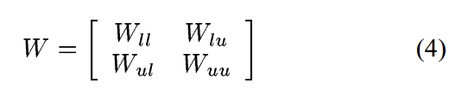

harmonic energy minimization
=>
Each part is known

Slide 9
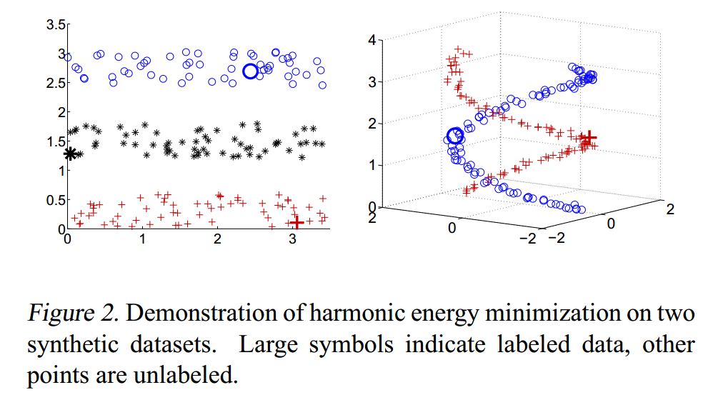
Examples
Question: Can kNN make the same performance in the right figure?
Answer: No, it is hard to follow the structure of the data

Slide 10
Interpretation
Random Walk
f(i) is the probability that starting from node i, it finally hits a labeled node with label 1

Slide 11

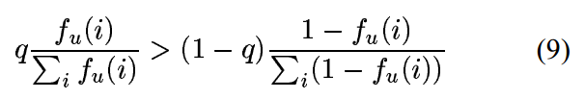
Incorporating Class Prior Knowledge
An obvious decision rule:
=
Another with prior knowledge:
=

Slide 12
Incorporating External Classifiers
dongle: classified externally as h_{u}
labeled
η
unlabeled

Slide 13
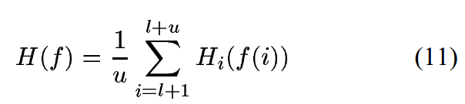



Learning the Weight Matrix

Slide 14
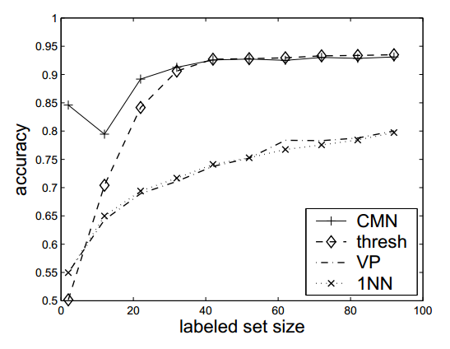

Experiment Results
thresh: label 1 if f(i) > 0.5
VP: voted perceptron, like SVM
1NN: kNN with k = 1
CMN: class mass normalization
Document categorization on PC (#982) vs. MAC (#961)

Slide 15
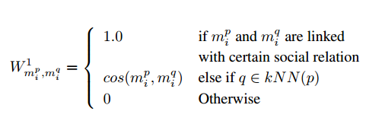
Applications with this model
Detect whether a mention is a morph mention

Slide 16
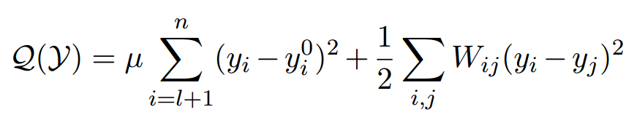

Some variance to this model
Consistency of labeled data
Graph energy
iterative solution

Slide 17
Thanks!
Yuchao Tao

